Slide 1
E-lEarning Portal
Presented ,
Aswathy sathyan
S6 mca

Slide 2

Introduction
Evolution of education technology

Slide 3
Technologies uses
Front end :- VS `NET 2017
Language :- asp.net with c#
INTERNET TOOLS :- html, javascript
Back end :- Sql server 2012

Slide 4
modules
Student
Faculty
Admin

Slide 5
Student module
Login : Student can login his account using id and password.
Documents : Student can view documents like notes, video tutorials and reports uploaded by faculty.
Online Quiz : Students can attend Online Quiz.
Quiz Report : Students can view their pervious Quiz Results.
Queries : Students can post queries and can view the reply given by the faculties.

Slide 6
2. Faculty module
Login: Faculty can login his account using id and password.
Upload: Faculty can upload notes, seminar/assignment reports and video tutorials.
Manage Quiz : Faculty can add quiz categories and questions for online quiz.
View: Faculty can view all student details.
Quiz Report : Faculties can view the quiz result of their students.
View queries: Faculty can view all the queries posted by students.
Reply: Faculty can give reply for the queries.

Slide 7
3. Admin module
Login: Admin can login using his Login Credentials.
Manage Faculty: Admin can view, add or delete Faculty Details.
Manage Student: Admin can view, add or delete Student Details.
Document Verification: Admin can view and verify Notes and Reports uploaded by the faculty.
View Video Tutorials: Admin can view and verify Video Tutorials.
Manage Quiz: Admin can add or delete Questions on various Quiz Topics.
Quiz Report : Admin can view the Quiz Results of students.
Manage Queries : Admin can view and delete the Queries posted by the students.

Slide 8
Table design

Slide 9
1. User details
Field Name | Datatype | Constraints
User_Id | varchar(20) | Primary Key
User_Type | varchar(50) | Not Null
Name | varchar(100) | Not Null
Gender | varchar(10) | Not Null
Mobile_No | numeric(12, 0) | Not Null
Dob | date | Not Null
Email_Id | varchar(100) | Not Null
Religion | varchar(50)
Category | varchar(50)
Nationality | varchar(50)
Blood_Group | varchar(10)
Photo | varchar(MAX) | Not Null
Address | varchar(MAX) | Not Null
District | varchar(100) | Not Null
State | varchar(100) | Not Null
Pincode | numeric(7, 0) | Not Null

Slide 10
Continuous…
Field Name | Datatype | Constraints
Father_Name | varchar(50)
Occupation | varchar(50)
F_Mob_No | numeric(10, 0)
Joining_Date | date | Not Null
Admitted_Program | varchar(MAX)
Branch | varchar(MAX)
Department | varchar(50) | Not Null
Admission_No | varchar(50) | Not Null
Username | varchar(50)
Password | varchar(50)
Semester | int

Slide 11
2. Qualification Details
Field Name | Datatype | Constraints
Qual_Id | int | Primary Key
User_Id | varchar(20) | Foreign Key(User_Details)
Qualification | varchar(100) | Not Null
Specialization | Varchar(100) | Not Null
College | Varchar(MAX) | Not Null
University | Varchar(MAX) | Not Null
CGPA | Float
Percentage | Float | Not Null

Slide 12
3. Experience Details
Field Name | Datatype | Constraints
Exp_Id | Int | Primary Key
User_Id | Varchar(20) | Foreign Key(User_Details)
Organization_Worked | Varchar(MAX) | Not Null
Designation | Varchar(MAX) | Not Null
From_Date | Date | Not Null
To_Date | Date | Not Null
Duration | Varchar(50)

Slide 13
4. Uploaded documents
Field Name | Datatype | Constraints
Doc_Id | Varchar(50) | Primary_Key
Doc_Type | Varchar(50) | Not Null
User_Id | Varchar(20) | Foreign Key(User_Details)
Subject | Varchar(MAX) | Not Null
Topic | Varchar(MAX) | Not Null
Document_File | Varchar(MAX) | Not Null
Description | Varchar(MAX)
Status | Varchar(50)

Slide 14
5. Quiz category
Field Name | Datatype | Constraints
C_Id | Varchar(20) | Primary Key
Category | Varchar(100) | Not Null
Image | Varchar(MAX) | Not Null
Created_By | Varchar(20) | Foreign_Key(User_Details)
Created_On | Date | Not Null

Slide 15
6. SubCategory
Field Name | Datatype | Constraints
SubCat_Id | Varchar(20) | Primary_Key
SubCategory | Varchar(Max) | Not Null
Image | Varchar(MAX) | Not Null
C_Id | Varchar(20) | Foreign key(Category)
Created_By | Varchar(100) | Foreign key(User_details_
Created_On | Date | Not Null

Slide 16
7. Quiz Questions
Field Name | Datatype | Constraints
Q_Id | Varchar(20) | Primary Key
Category_Id | Varchar(20) | Foreign key(Category)
Question | Varchar(MAX) | Not Null
Option A | Varchar(MAX) | Not Null
Option B | Varchar(MAX) | Not Null
Option C | Varchar(MAX) | Not Null
Option D | Varchar(MAX) | Not Null
Answer | Varchar(MAX) | Not Null
Description | Varchar(MAX) | Not Null
Created_By | Varchar(100) | Not Null
Created_On | Date | Not Null

Slide 17
8. Quiz Report
Field Name | Datatype | Constraints
Quiz_Id | Varchar(20) | Primary Key
User_Id | Varchar(20) | Foreign_key(User_Details)
Date | Date | Not Null
SubCategory | Varchar(MAX) | Not Null
Start_Time | Varchar(30) | Not Null
End_Time | Varchar(30) | Not Null
Correct_Answer | Int | Not Null
Incorrect_Answer | Int | Not Null
Attended_Qstn | Int | Not Null
Total_Score | Int | Not Null
Percentage | Numeric(2,2) | Not Null

Slide 18
9. Temporary questions
Field Name | Datatype | Constraints
Qstn_No | Int | Primary Key
Qstn_Id | Varchar(20) | Foreign key(Quiz_Questions)
Question | Varchar(MAX) | Not Null
Option A | Varchar(MAX) | Not Null
Option B | Varchar(MAX) | Not Null
Option C | Varchar(MAX) | Not Null
Option D | Varchar(MAX) | Not Null
Answer | Varchar(MAX) | Not Null
Selected_Option | Varchar(MAX)
Status | Varchar(MAX)

Slide 19
10. Query Details
Field Name | Datatype | Constraints
Query_Id | Varchar(20) | Primary_Key
QUser_Id | Varchar(20) | Foreign key(User_Details)
Subject | Varchar(100) | Not Null
Query | Varchar(MAX) | Not Null
Date | Date | Not Null

Slide 20
11. Query Reply
Field Name | Datatype | Constraints
Reply_id | Varchar(20) | Primary_Key
Query_Id | Varchar(20) | Foreign key(Query_Details)
RUser_Id | Varchar(20) | Not Null
Reply | Varchar(MAX) | Not Null
Date | Date | Not Null

Slide 21
screenshots

Slide 22
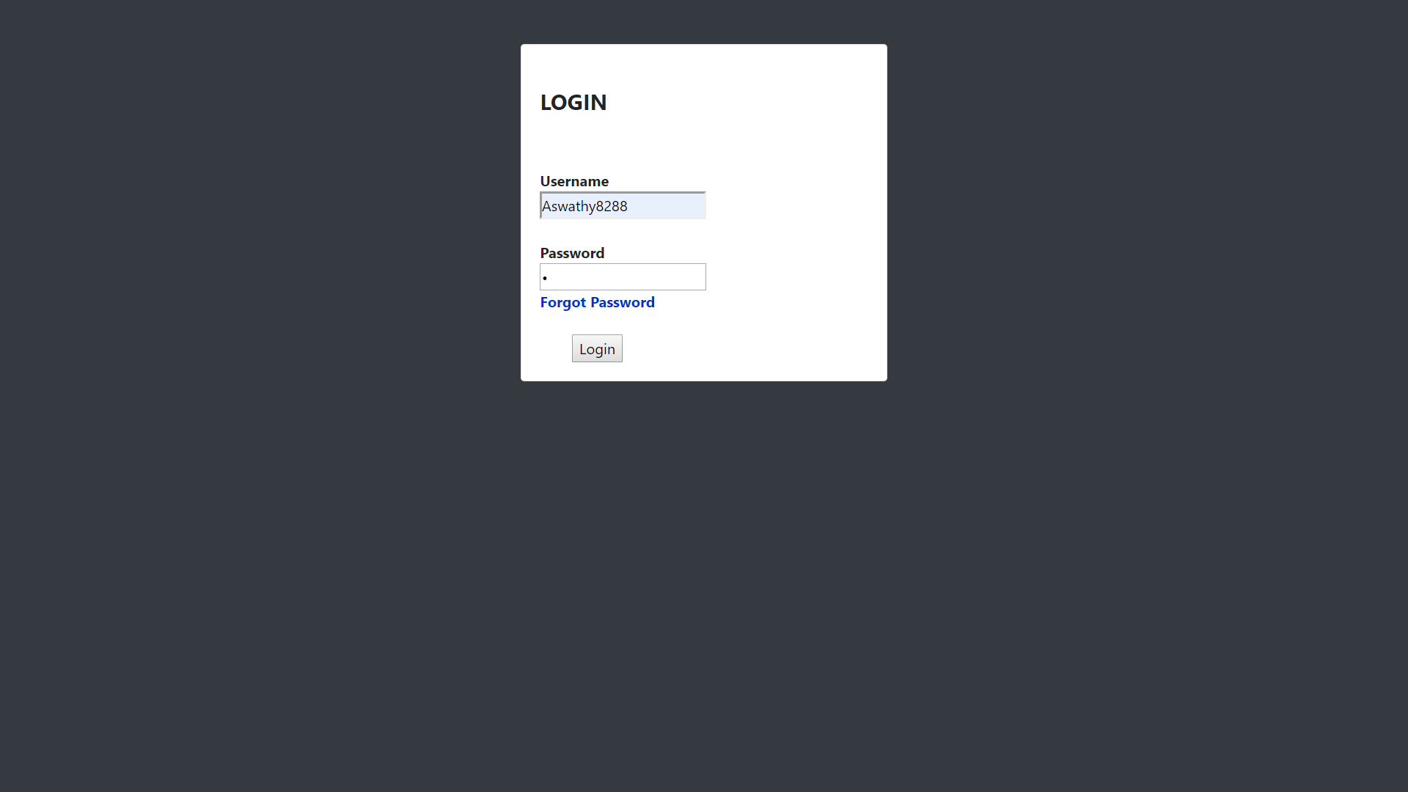
Login

Slide 23
Admin module

Slide 24
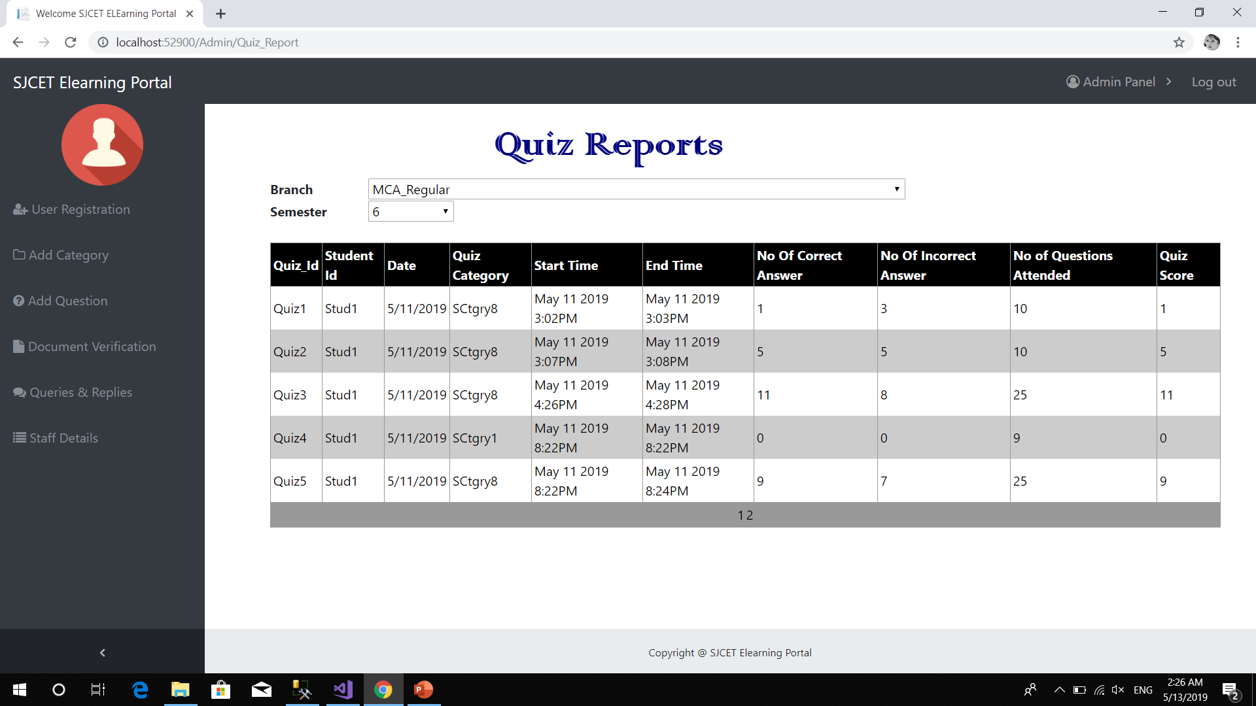
Students quiz report

Slide 25
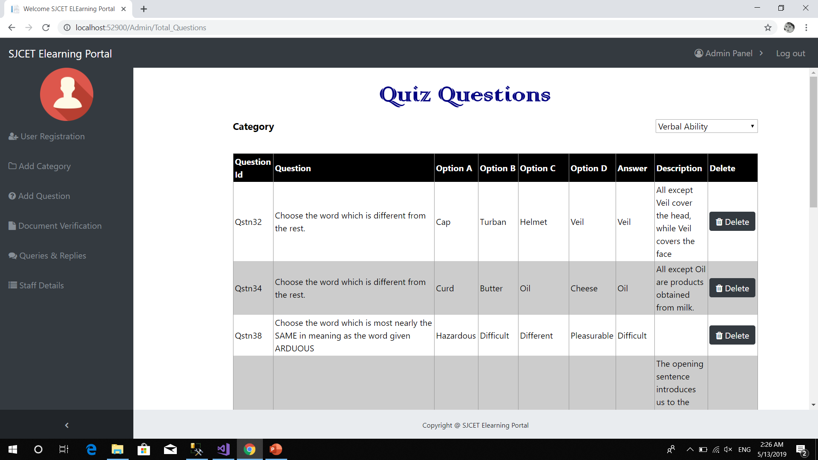
Manage quiz questions

Slide 26
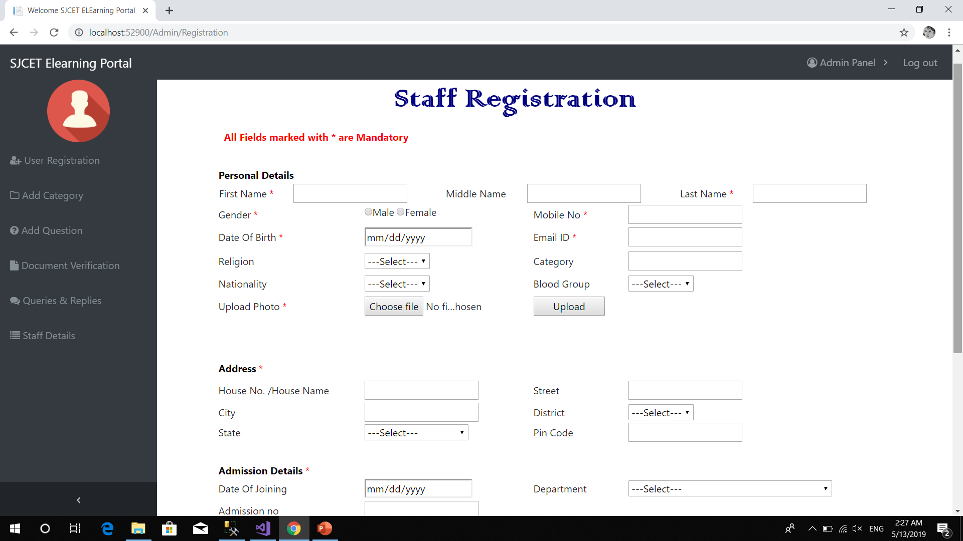
Staff registration

Slide 27
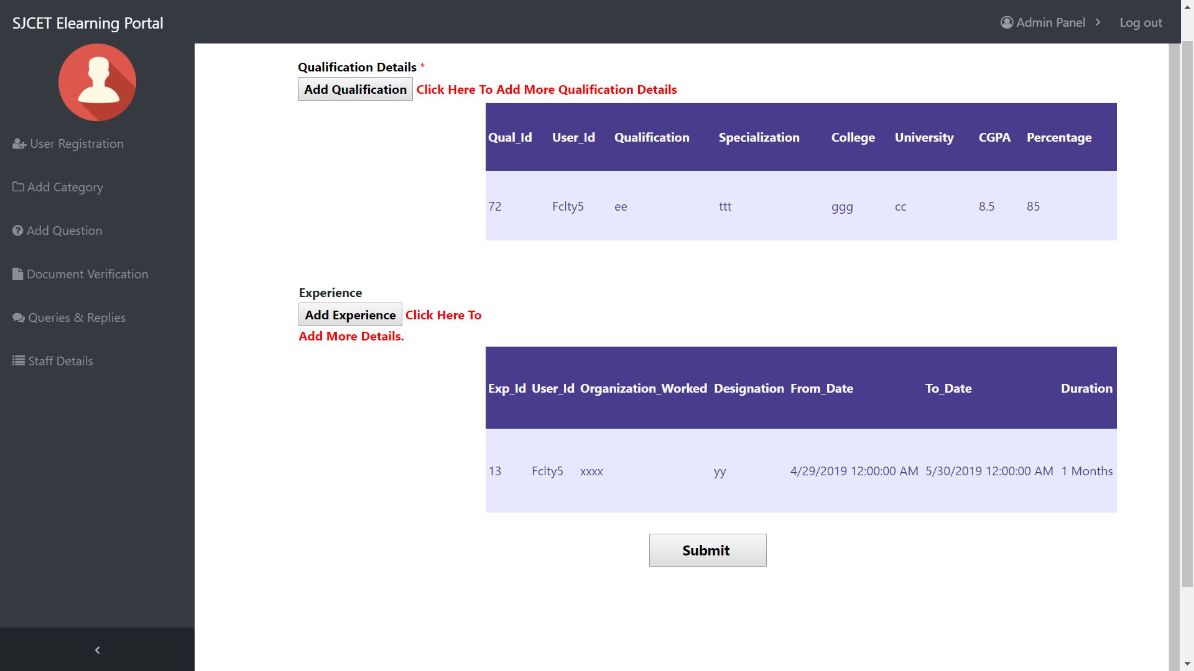

Slide 28
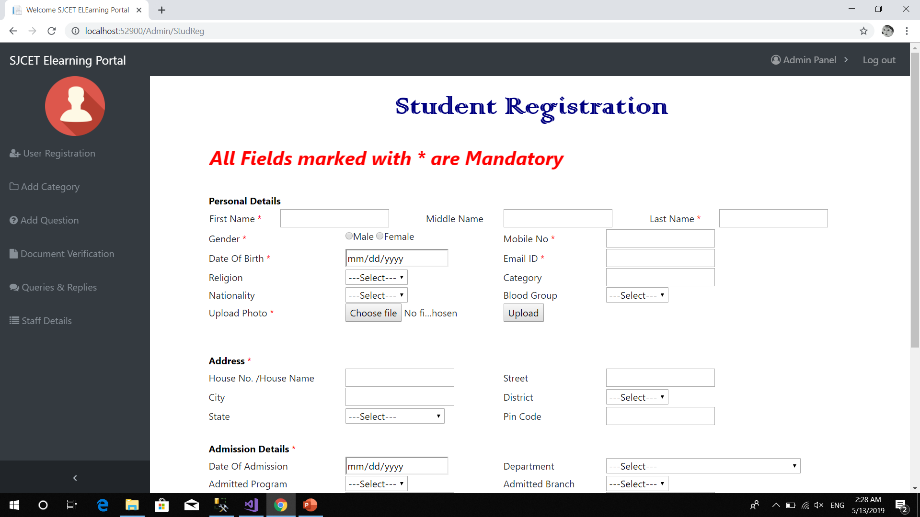
Student registartion

Slide 29
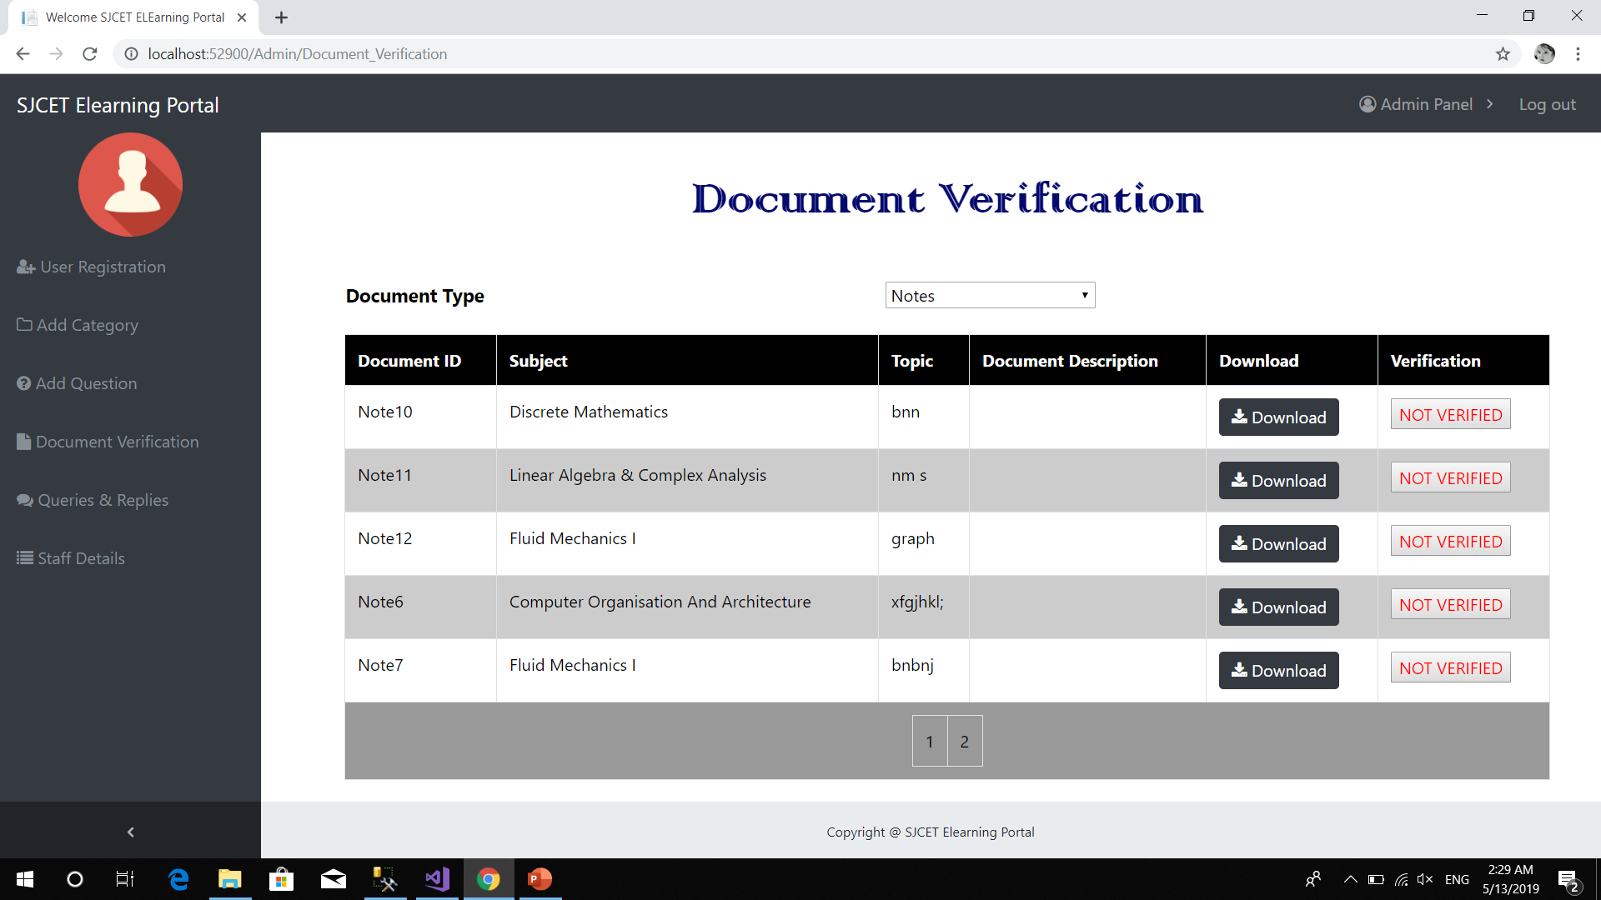
Document verification

Slide 30
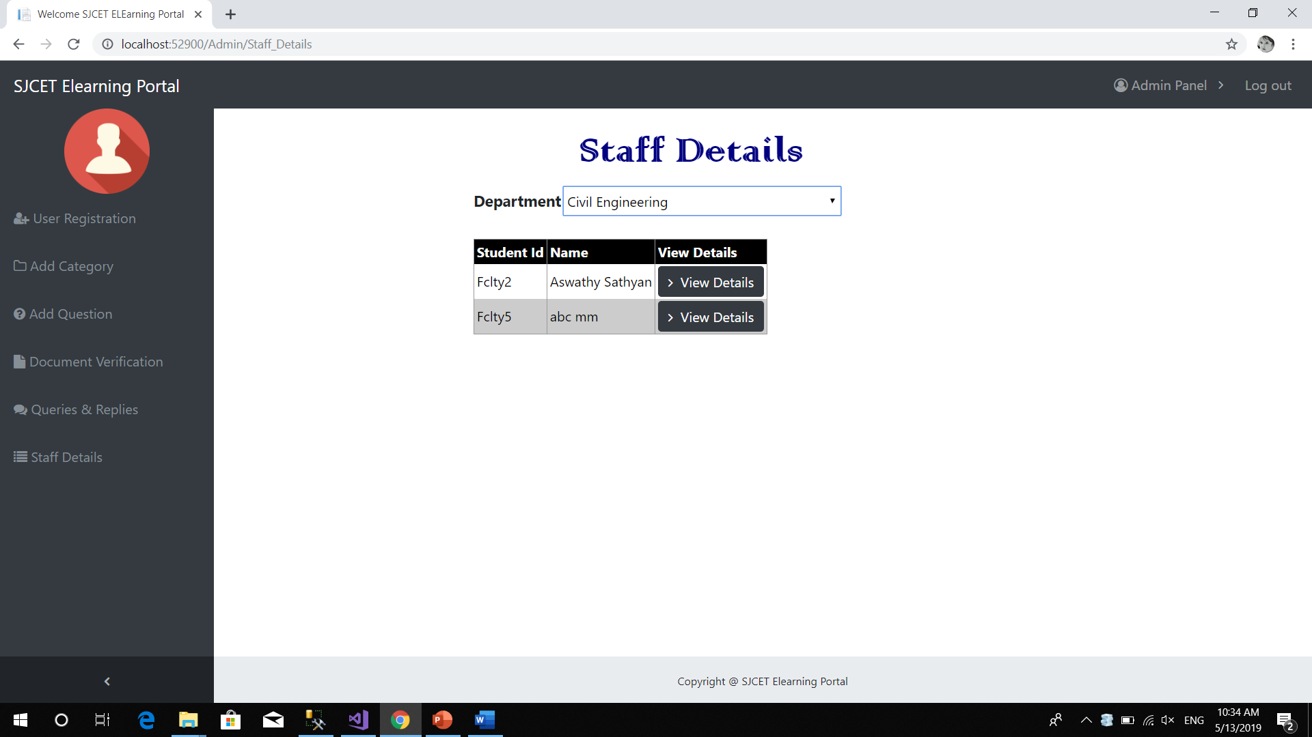
Staff details

Slide 31
Student module

Slide 32
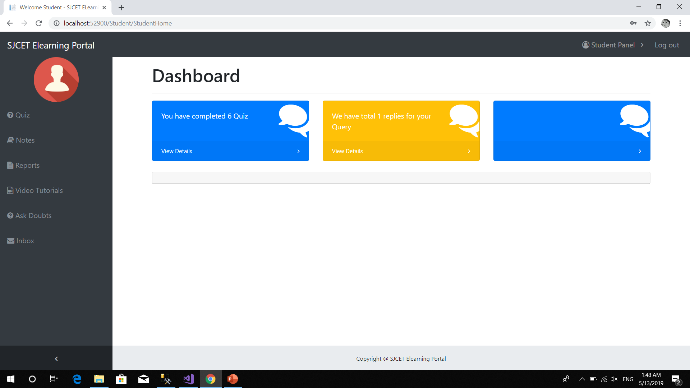
Student Home page

Slide 33
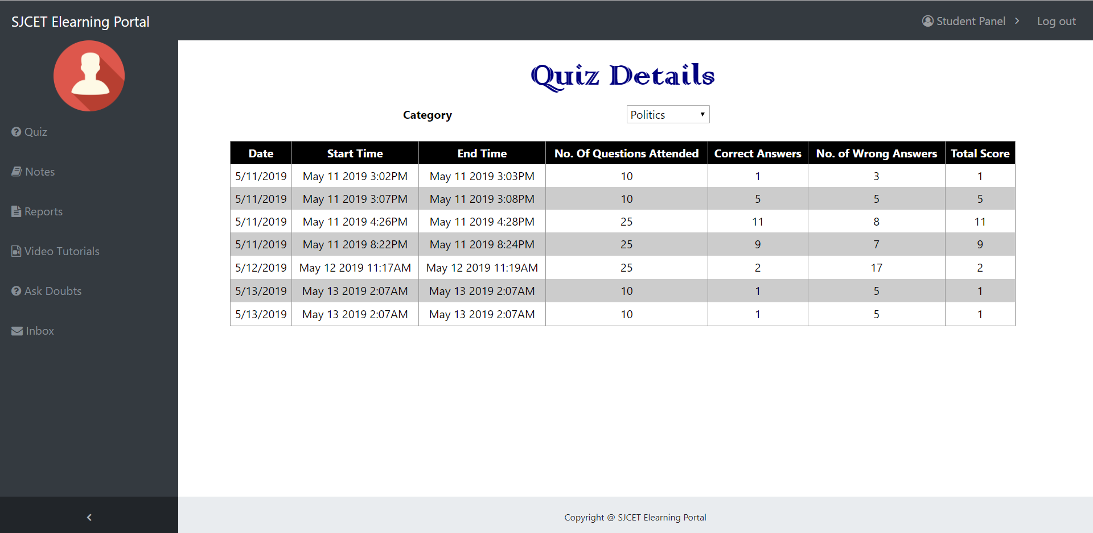
Quiz Report

Slide 34
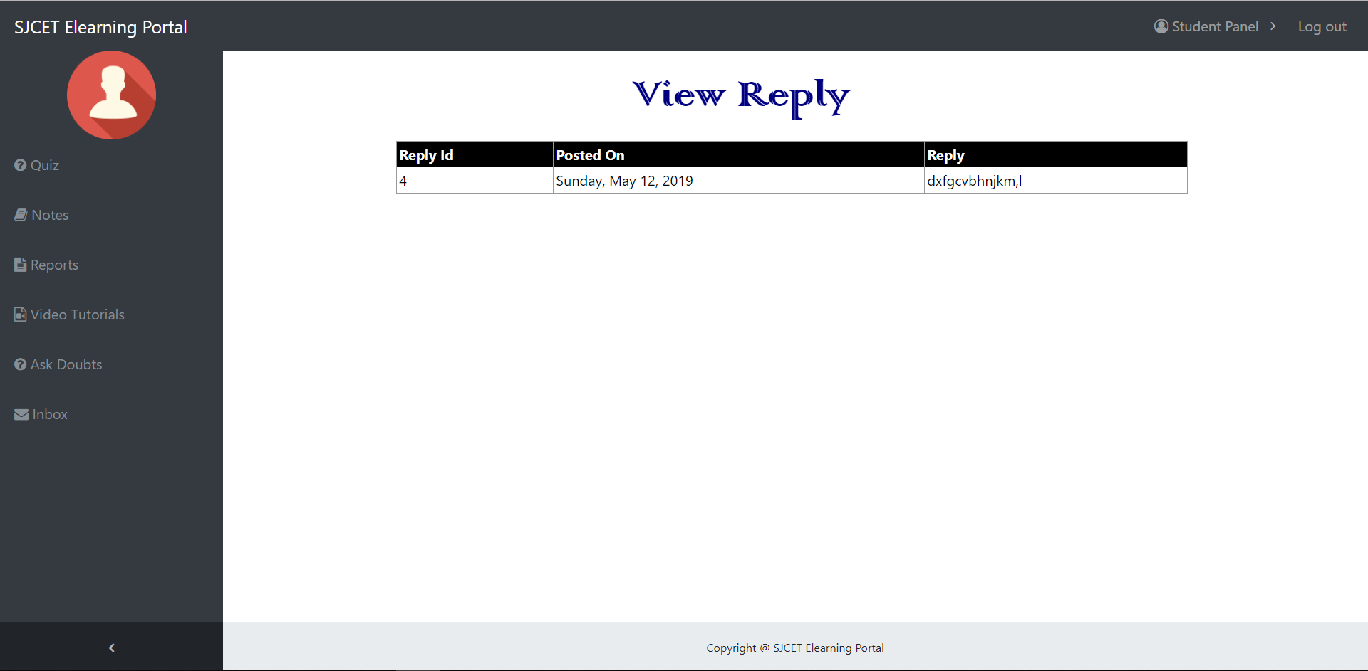
Query Reply

Slide 35
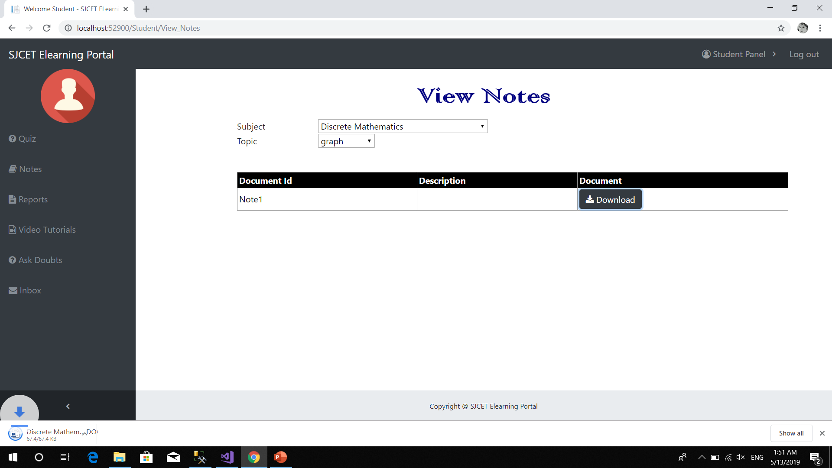
View Note

Slide 36
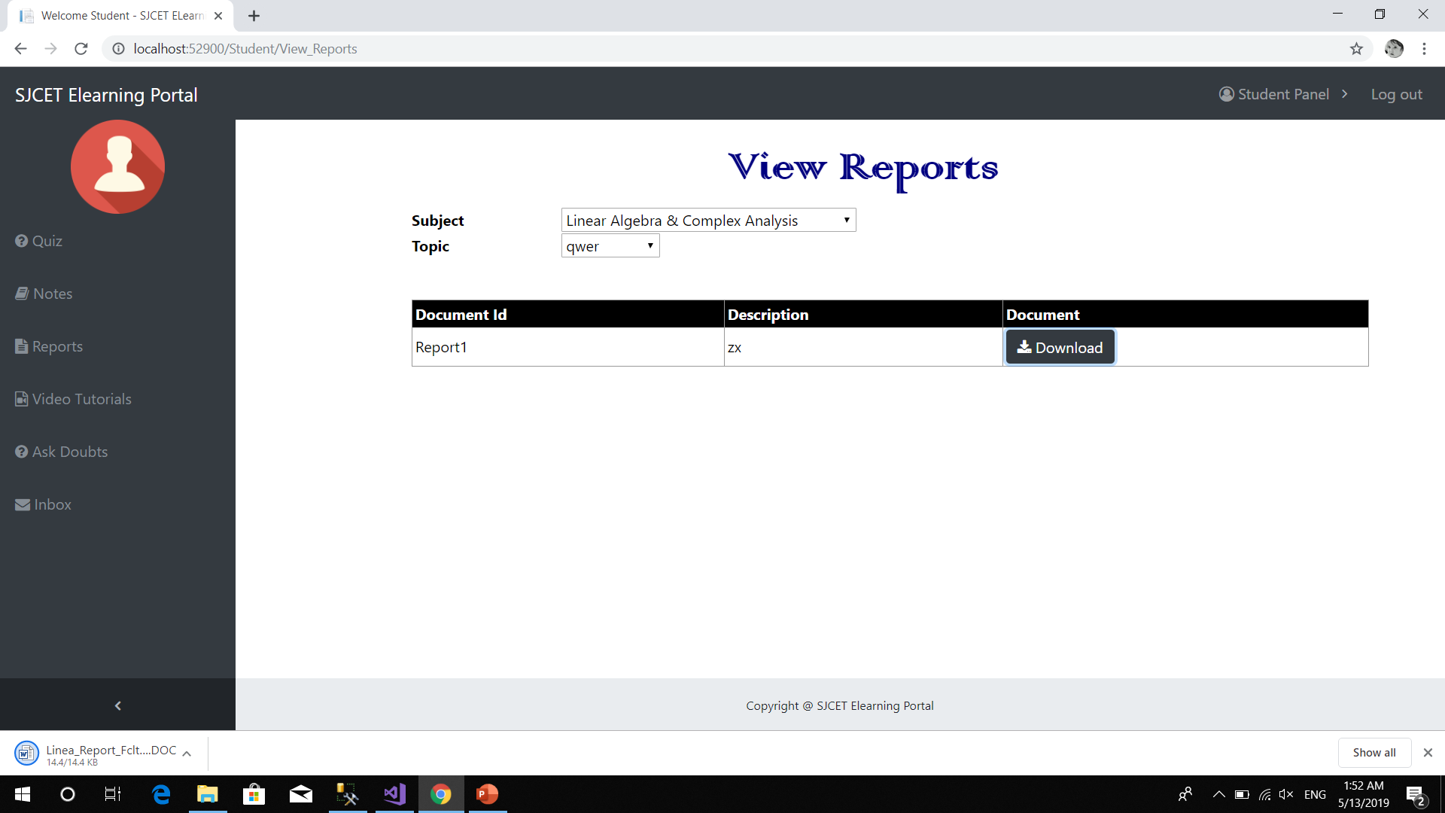
View Reports

Slide 37
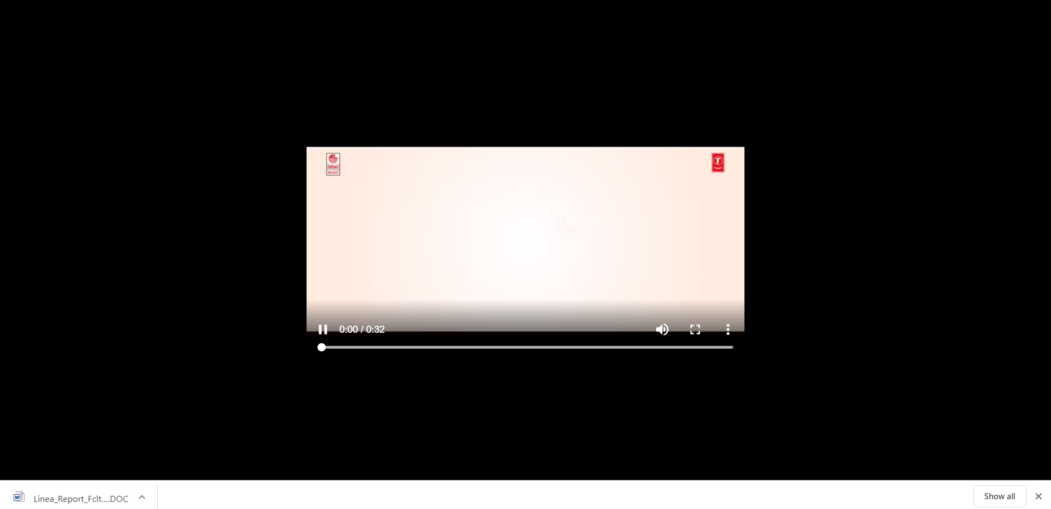
View video tutorial

Slide 38
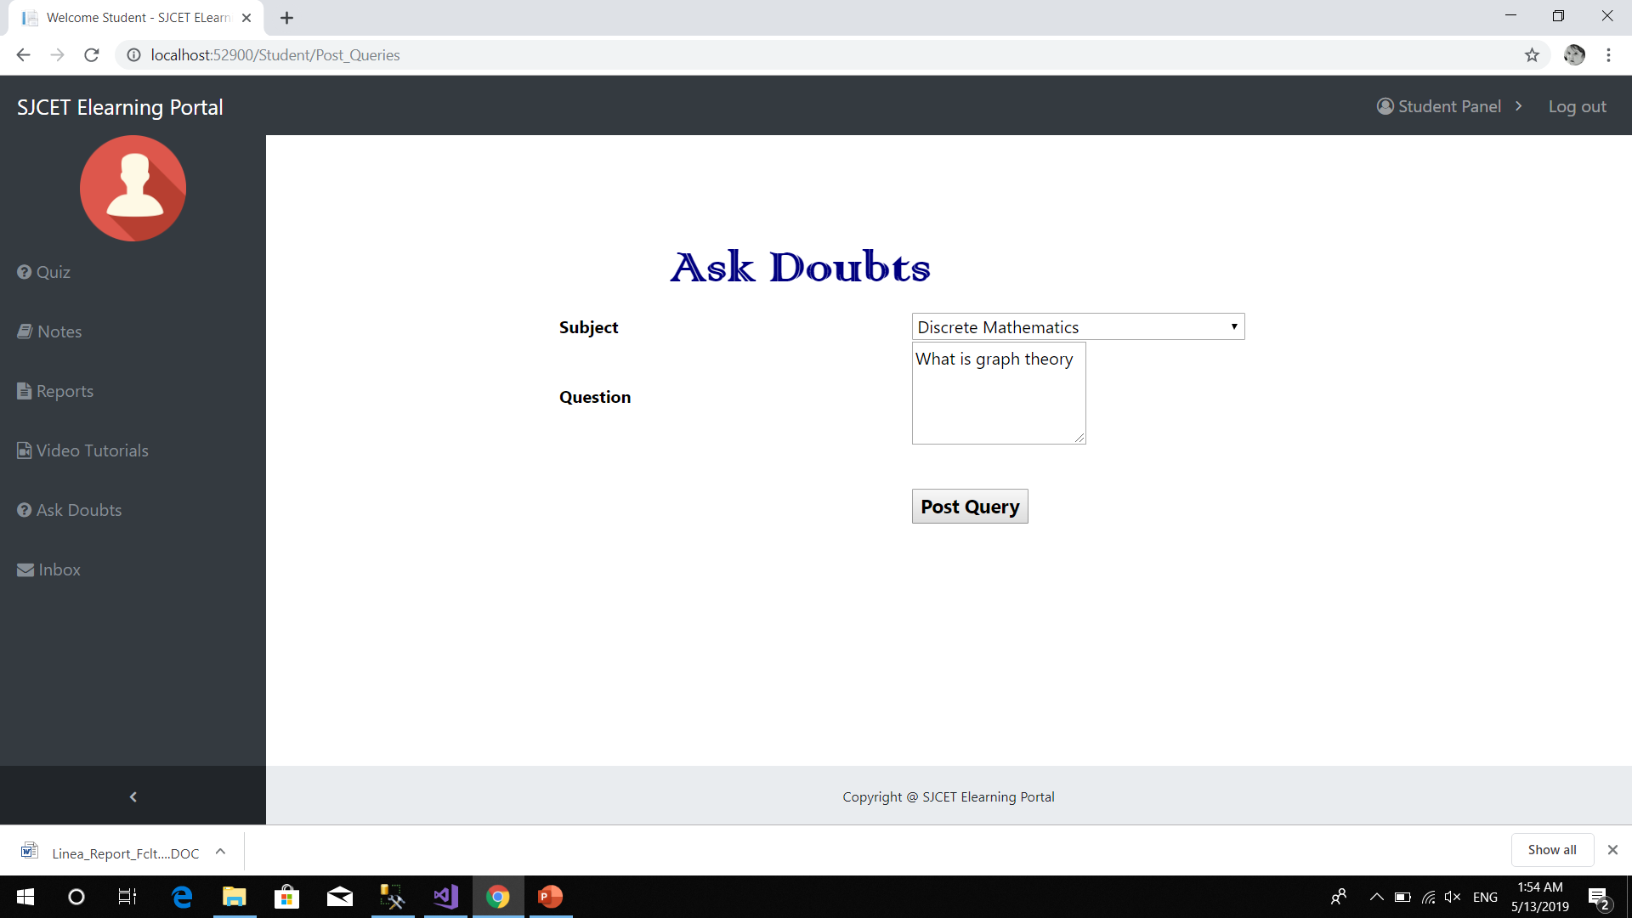
Post queries

Slide 39
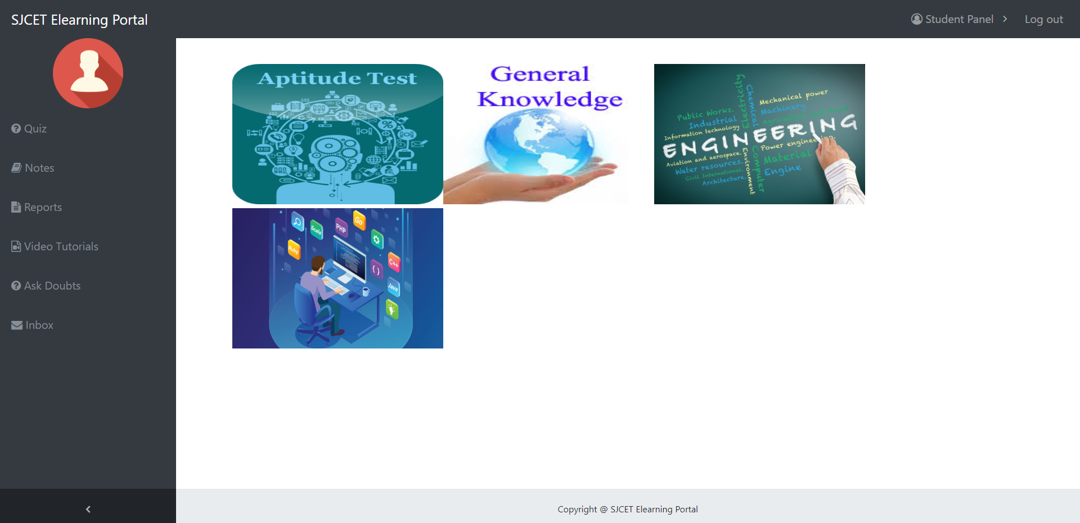
Online quiz

Slide 40

Select subcategory

Slide 41
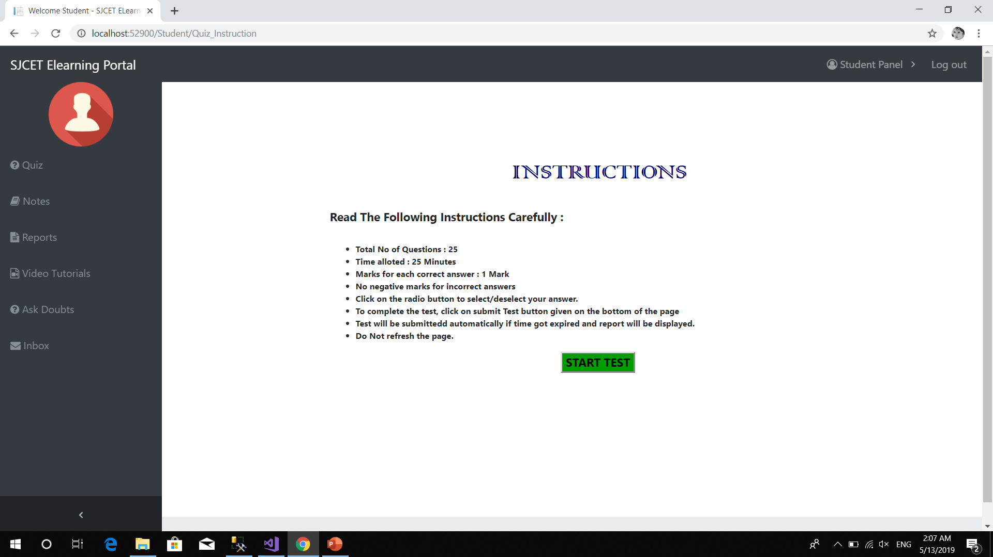

Slide 42
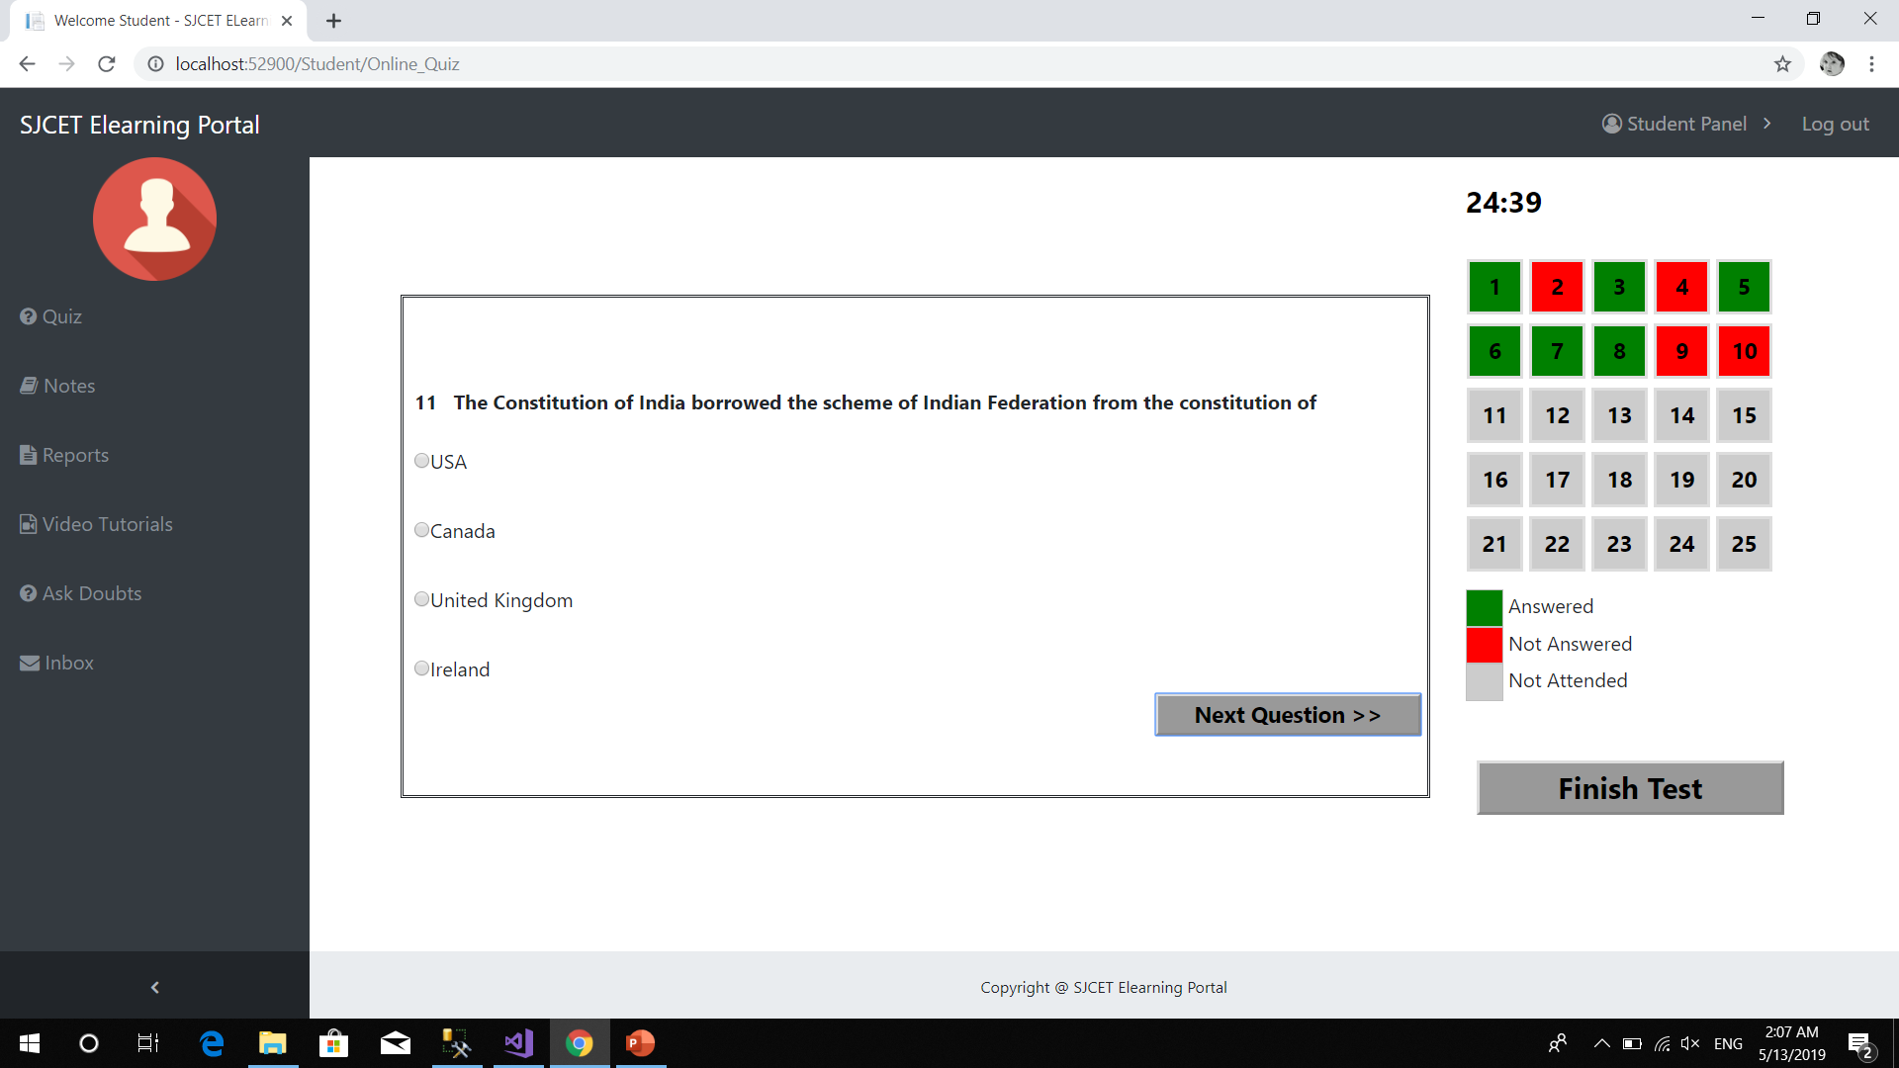

Slide 43
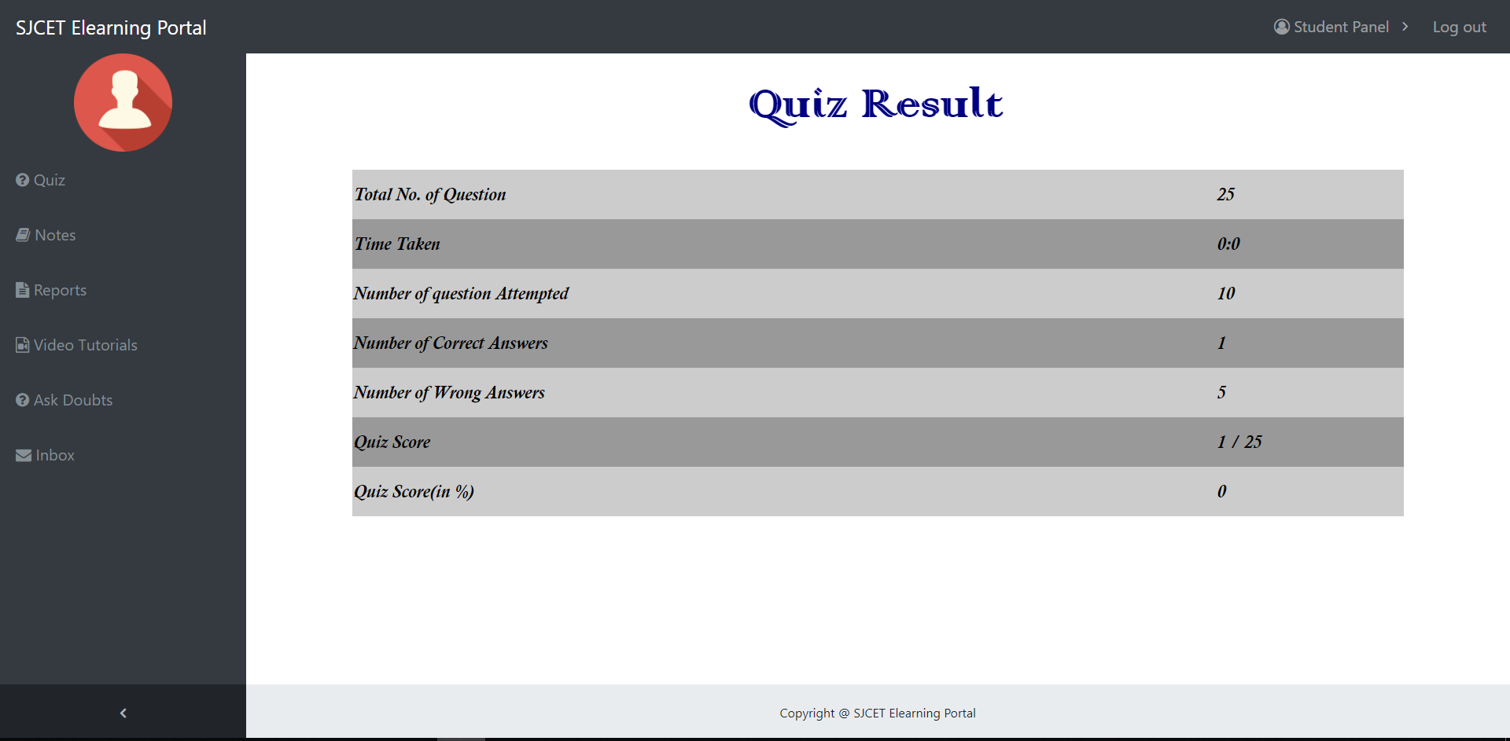
Quiz result

Slide 44
Faculty module

Slide 45
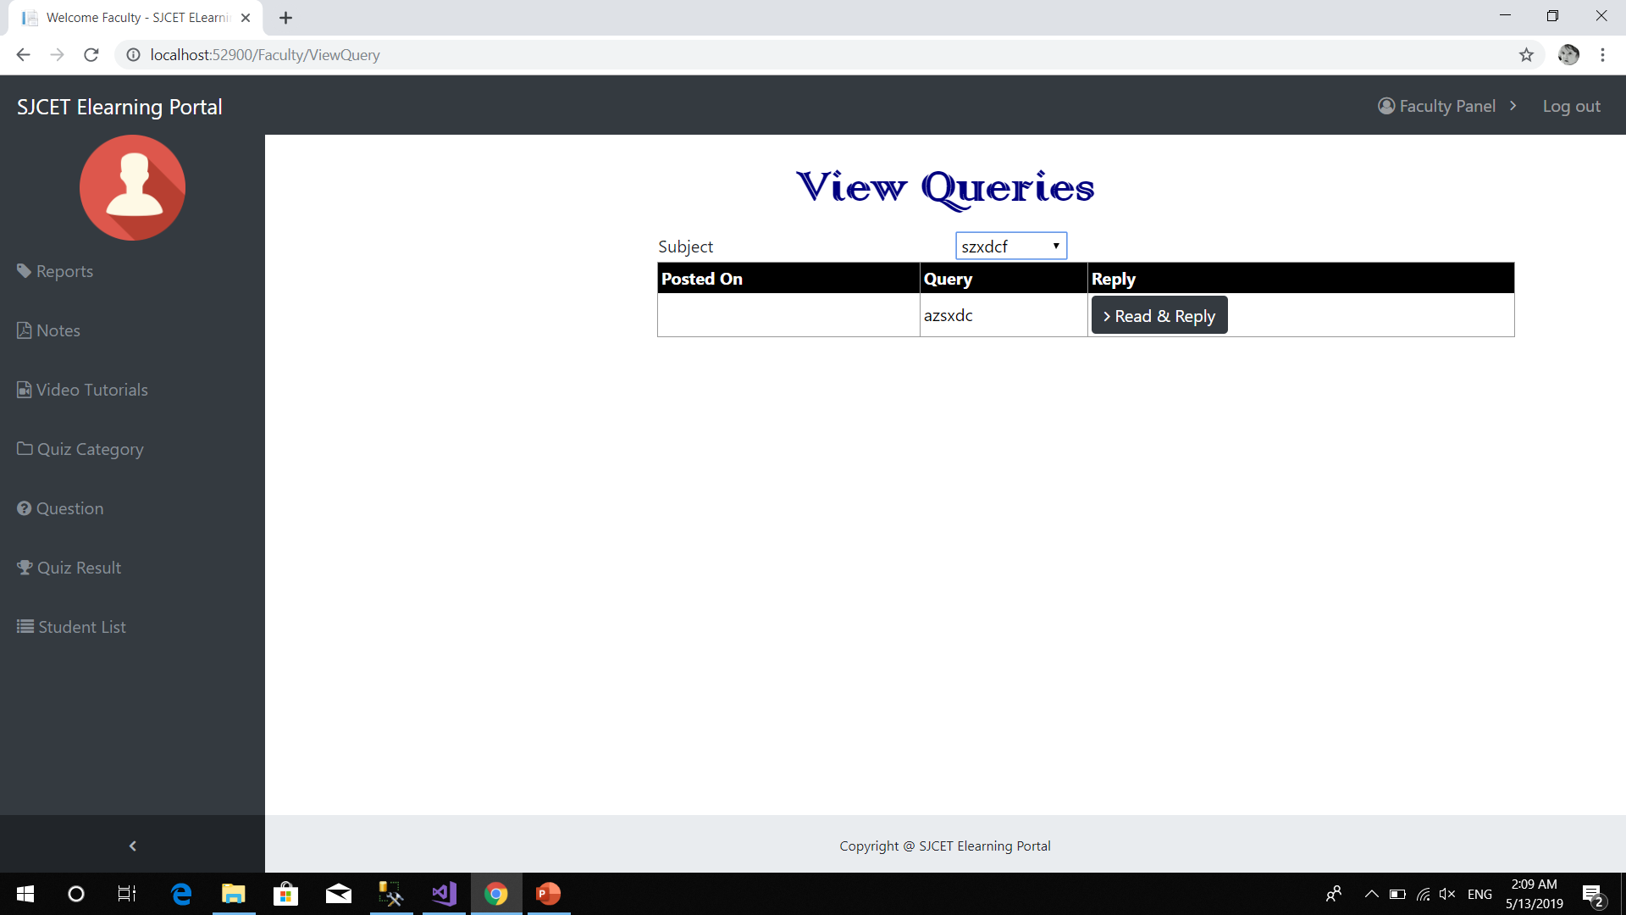
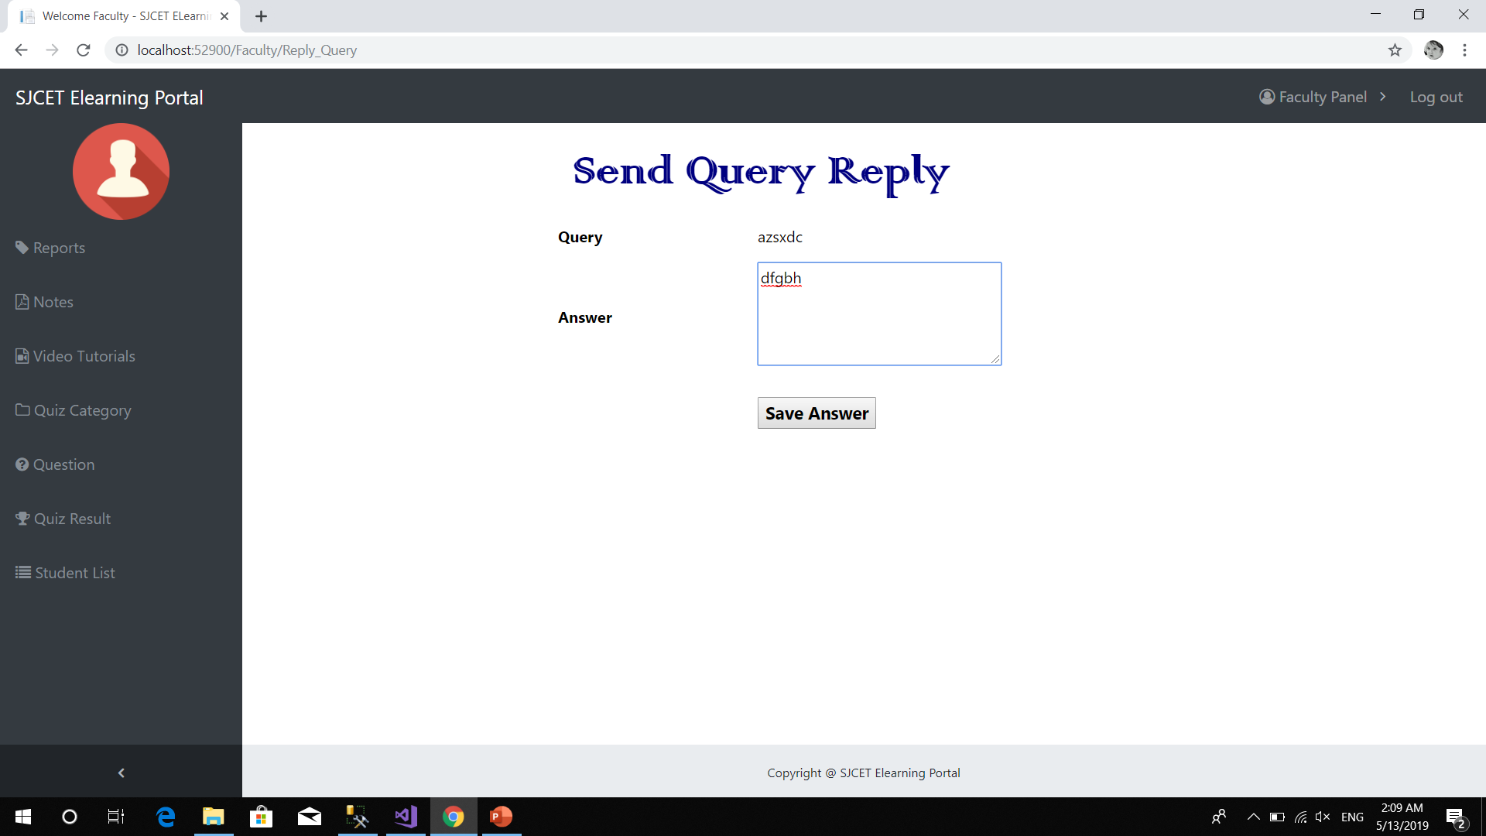
View queries & send reply

Slide 46

View quiz questions

Slide 47
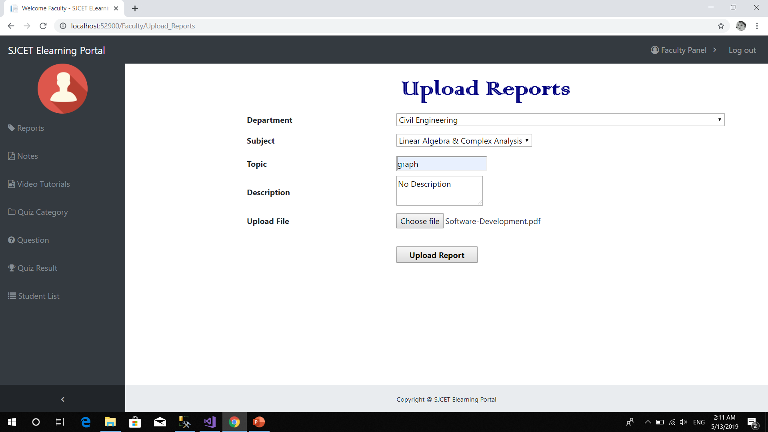
Upload Documents

Slide 48
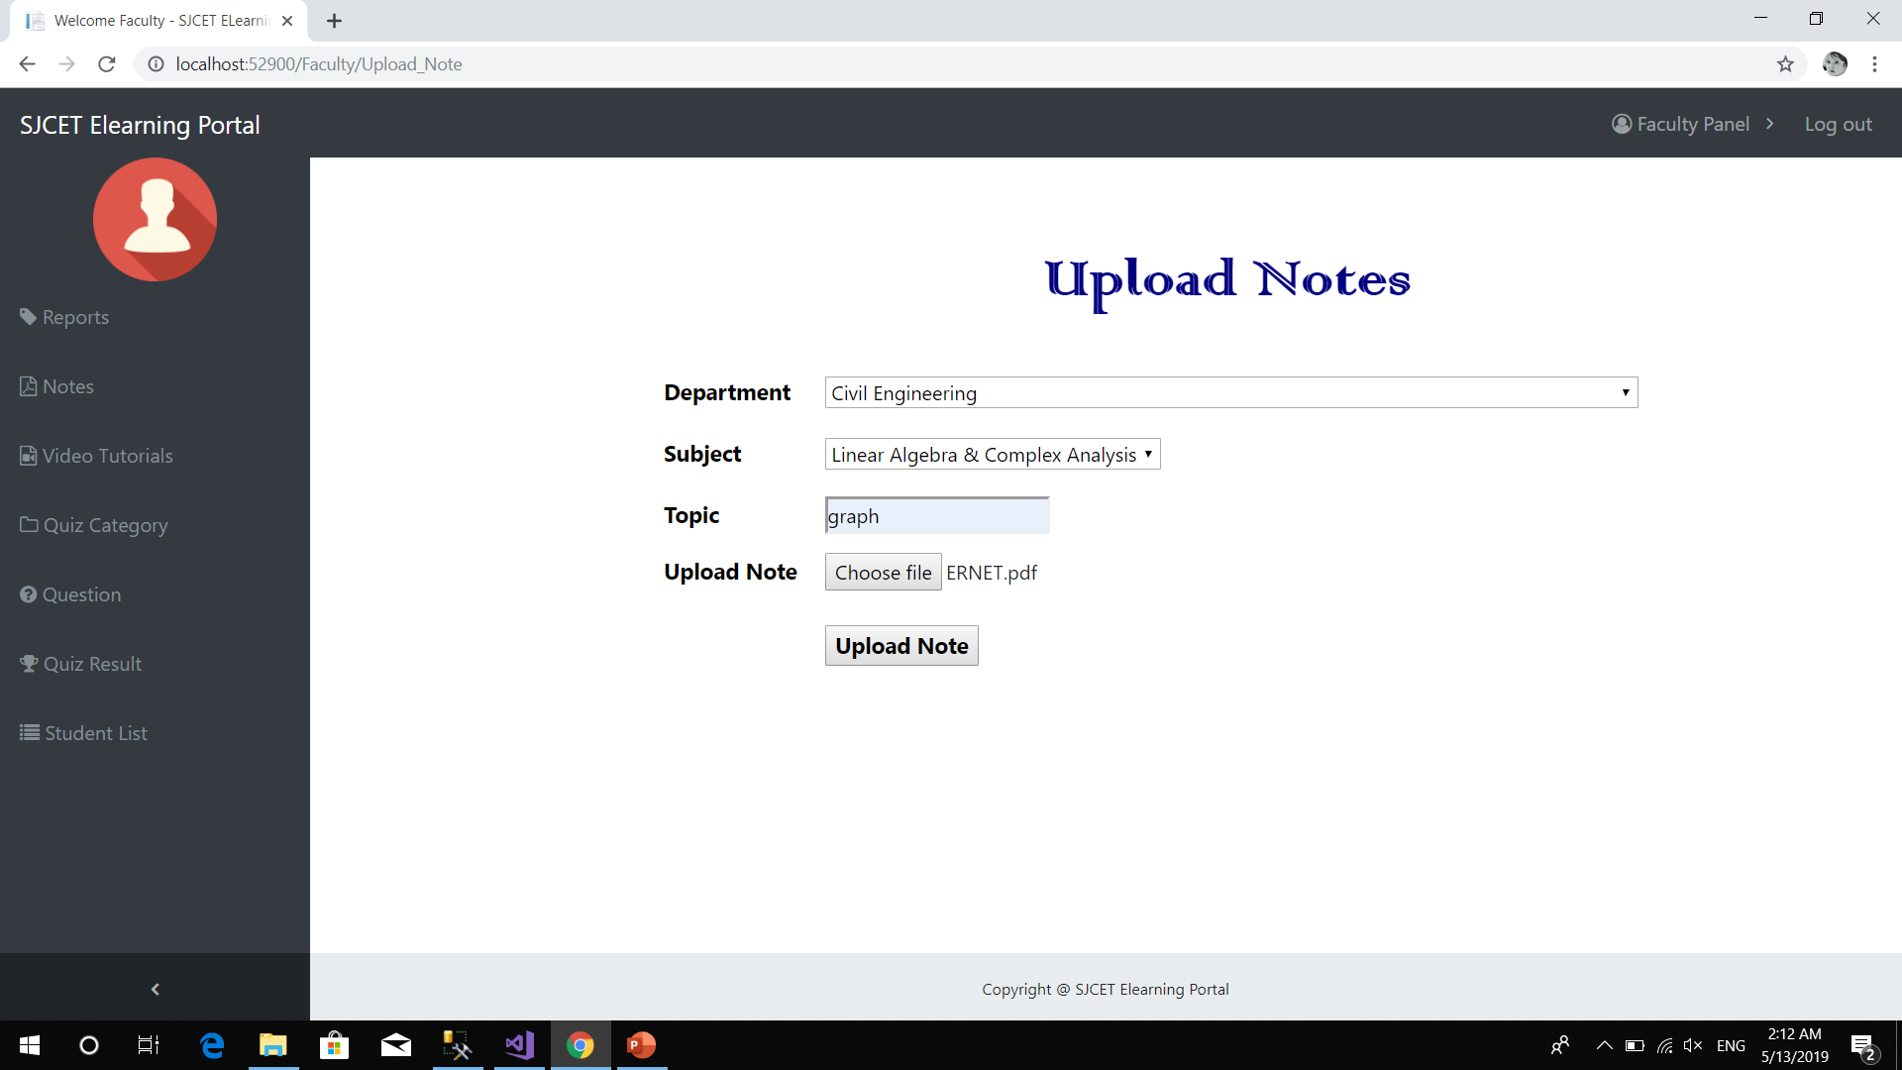

Slide 49
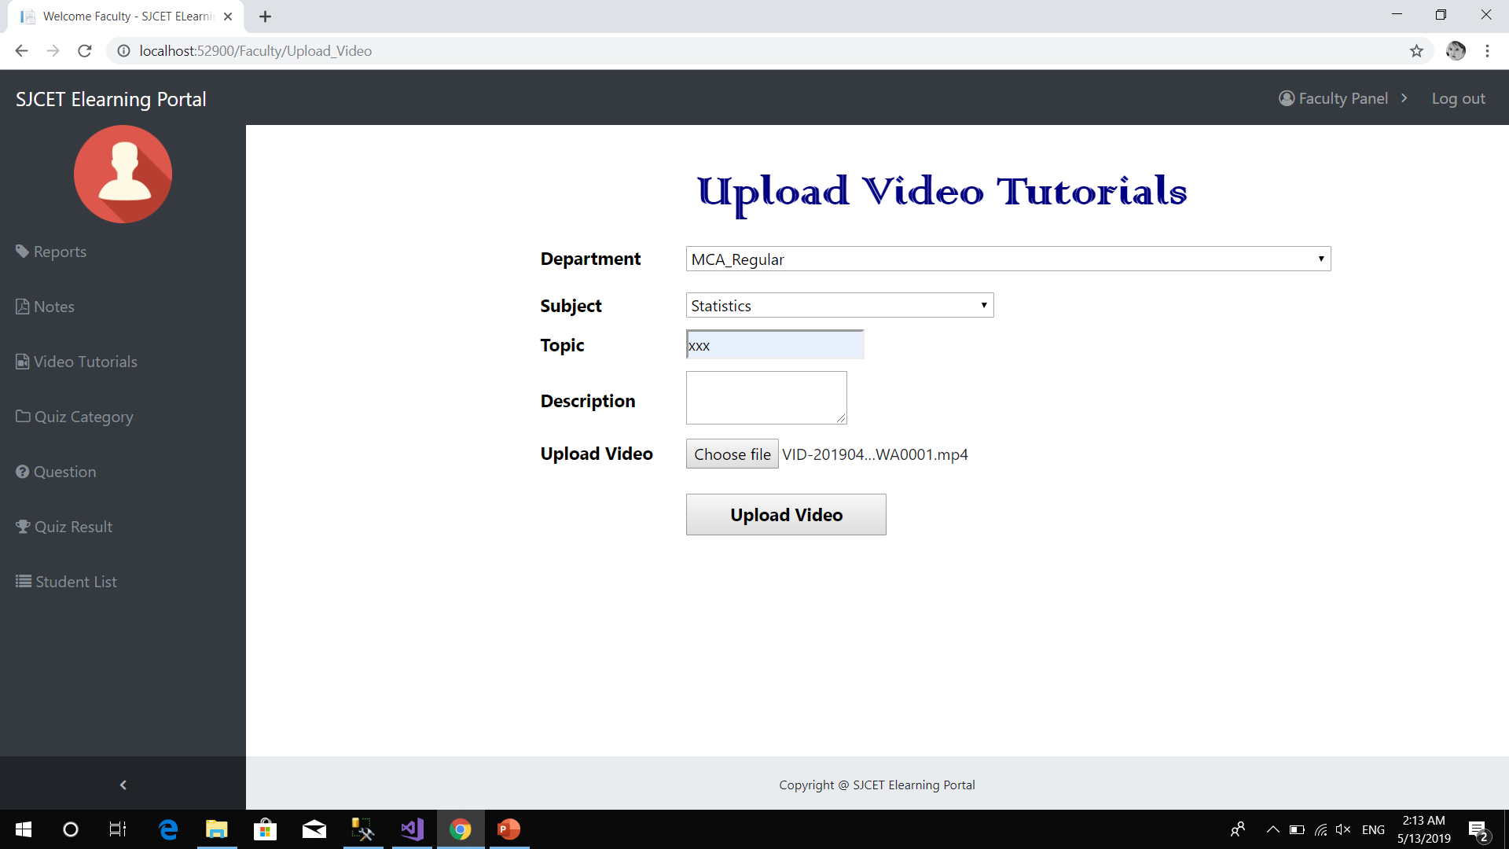

Slide 50
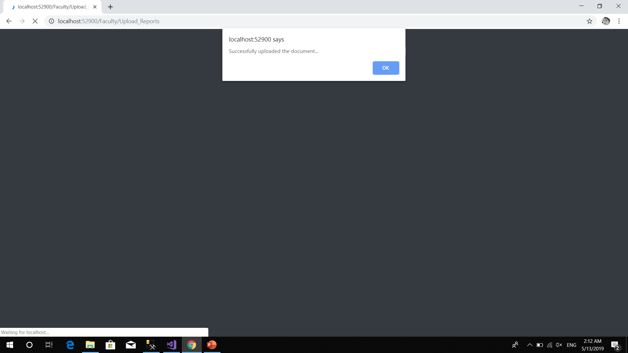

Slide 51
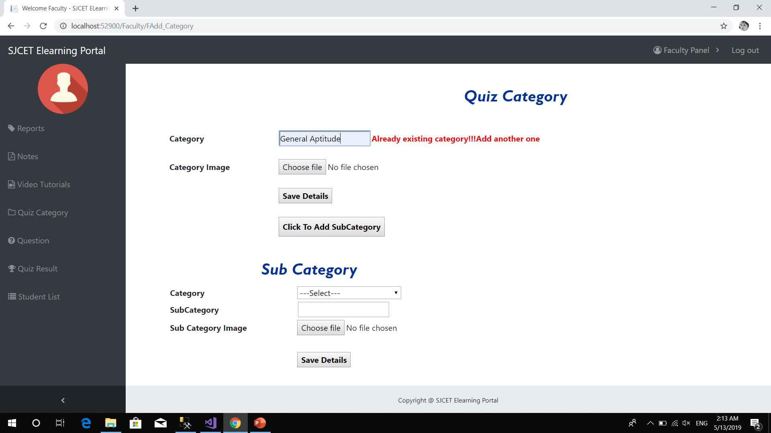
Quiz category

Slide 52
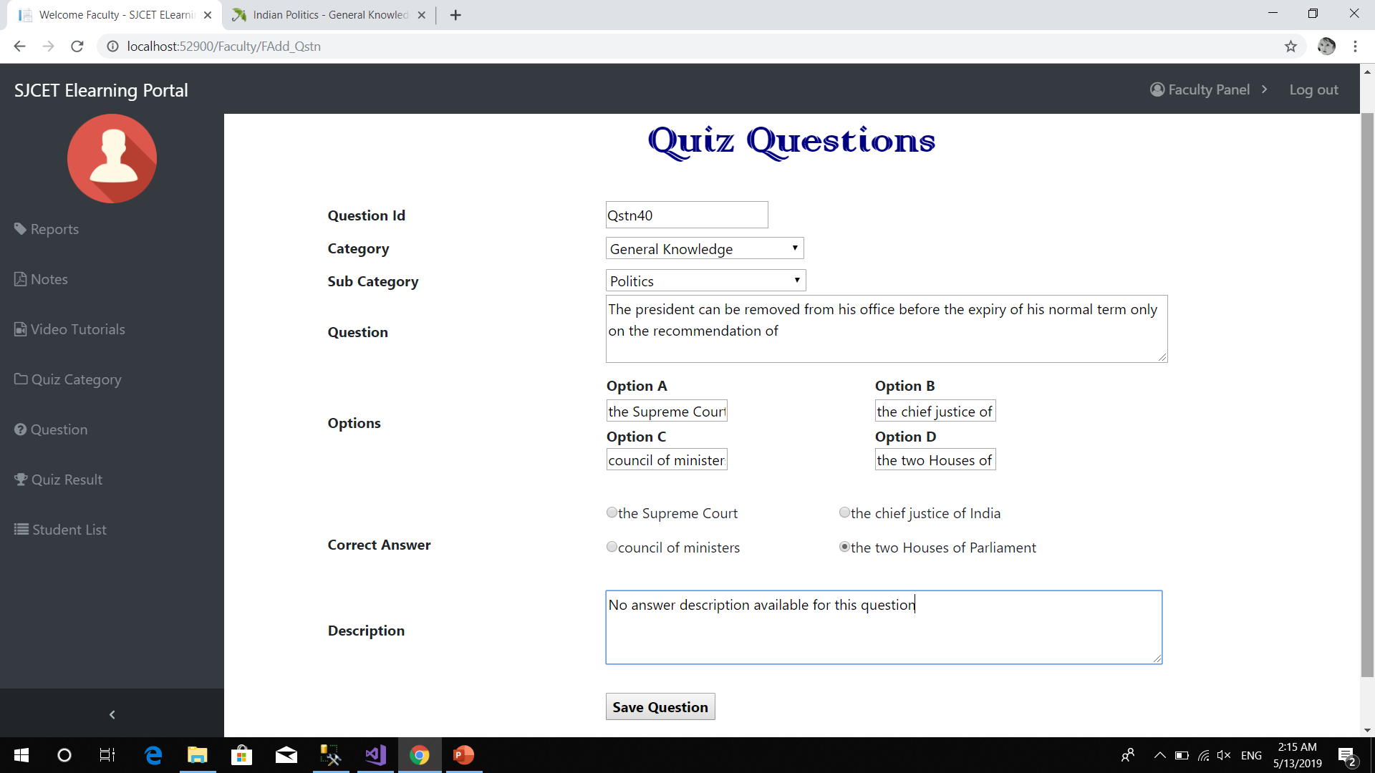
Add Quiz questions

Slide 53

Students quiz report

Slide 54
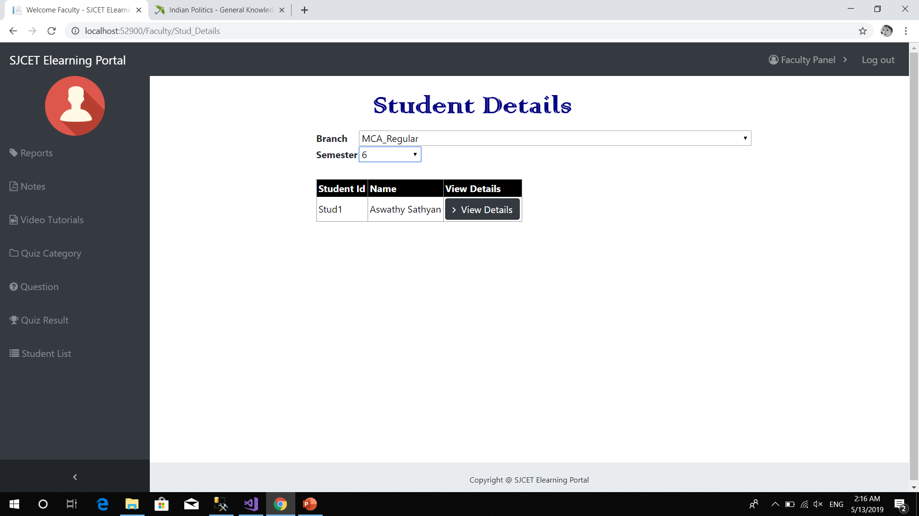
View student details

Slide 55
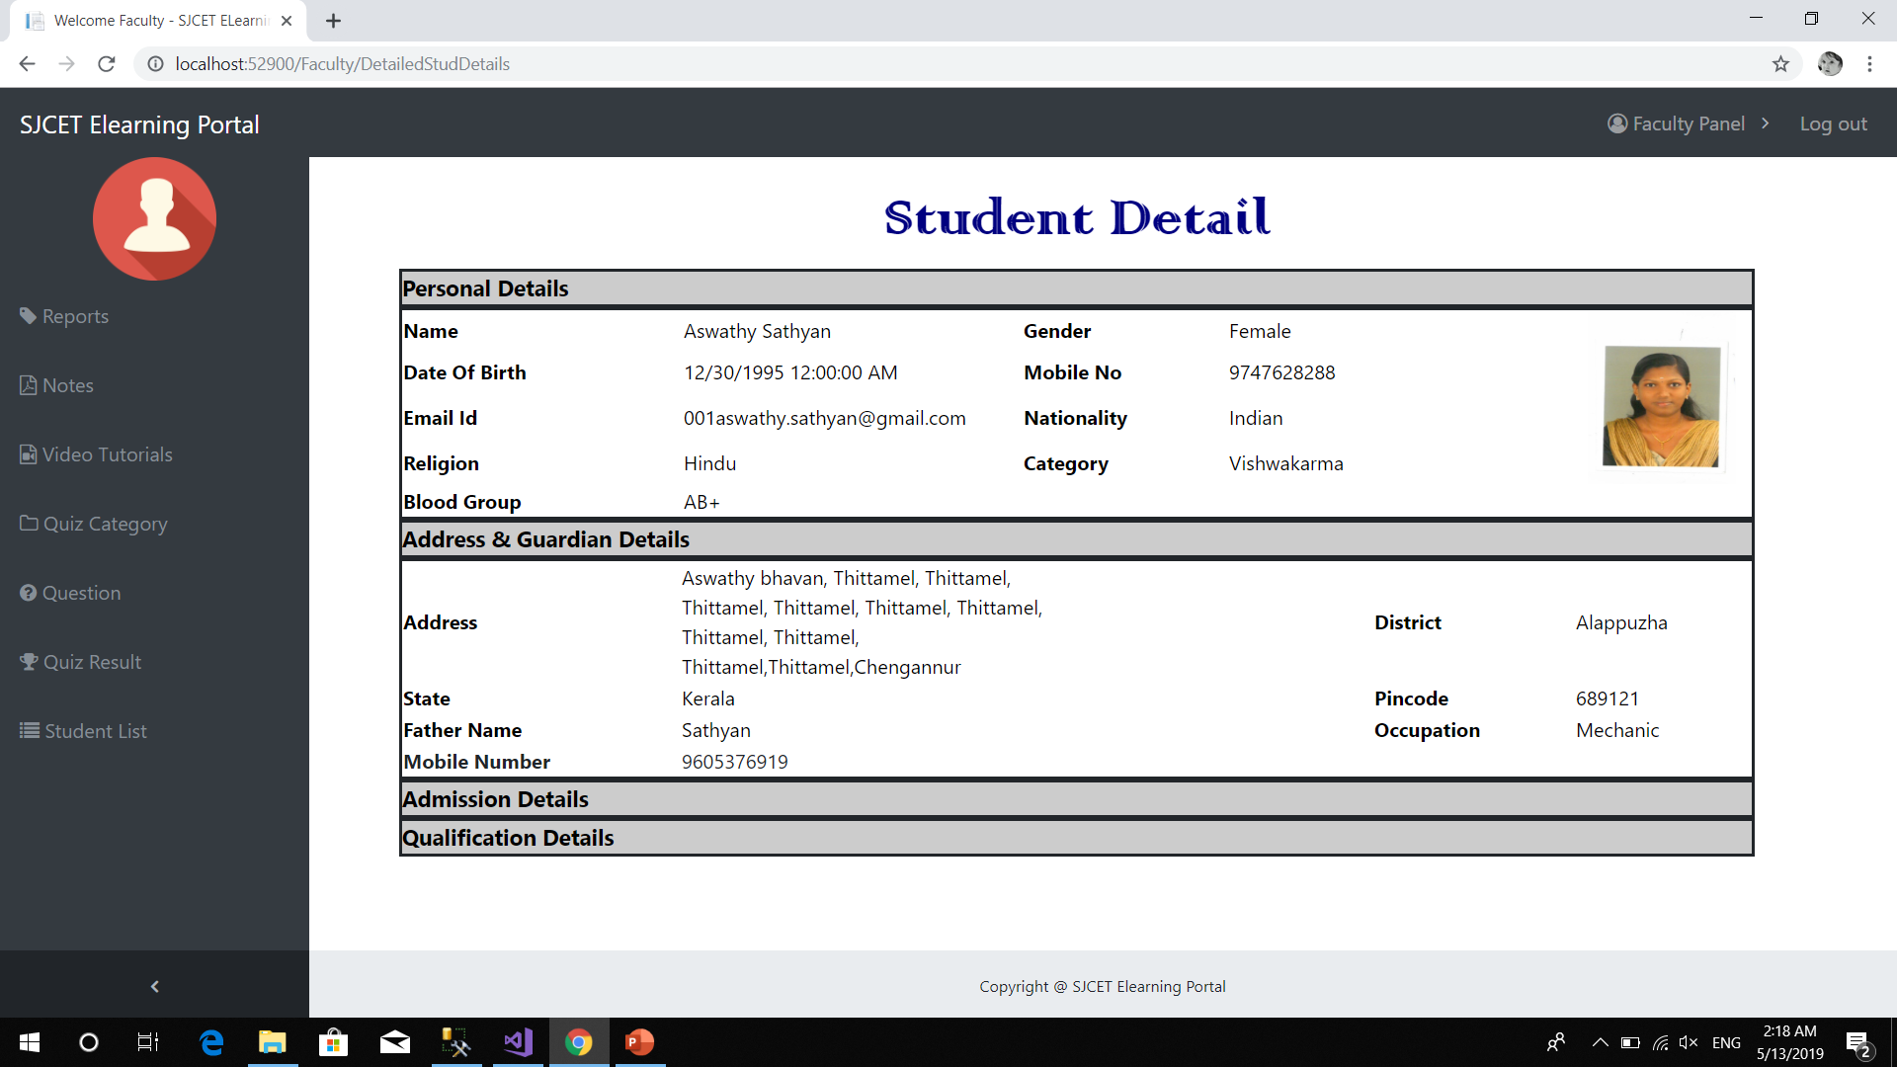

Slide 56
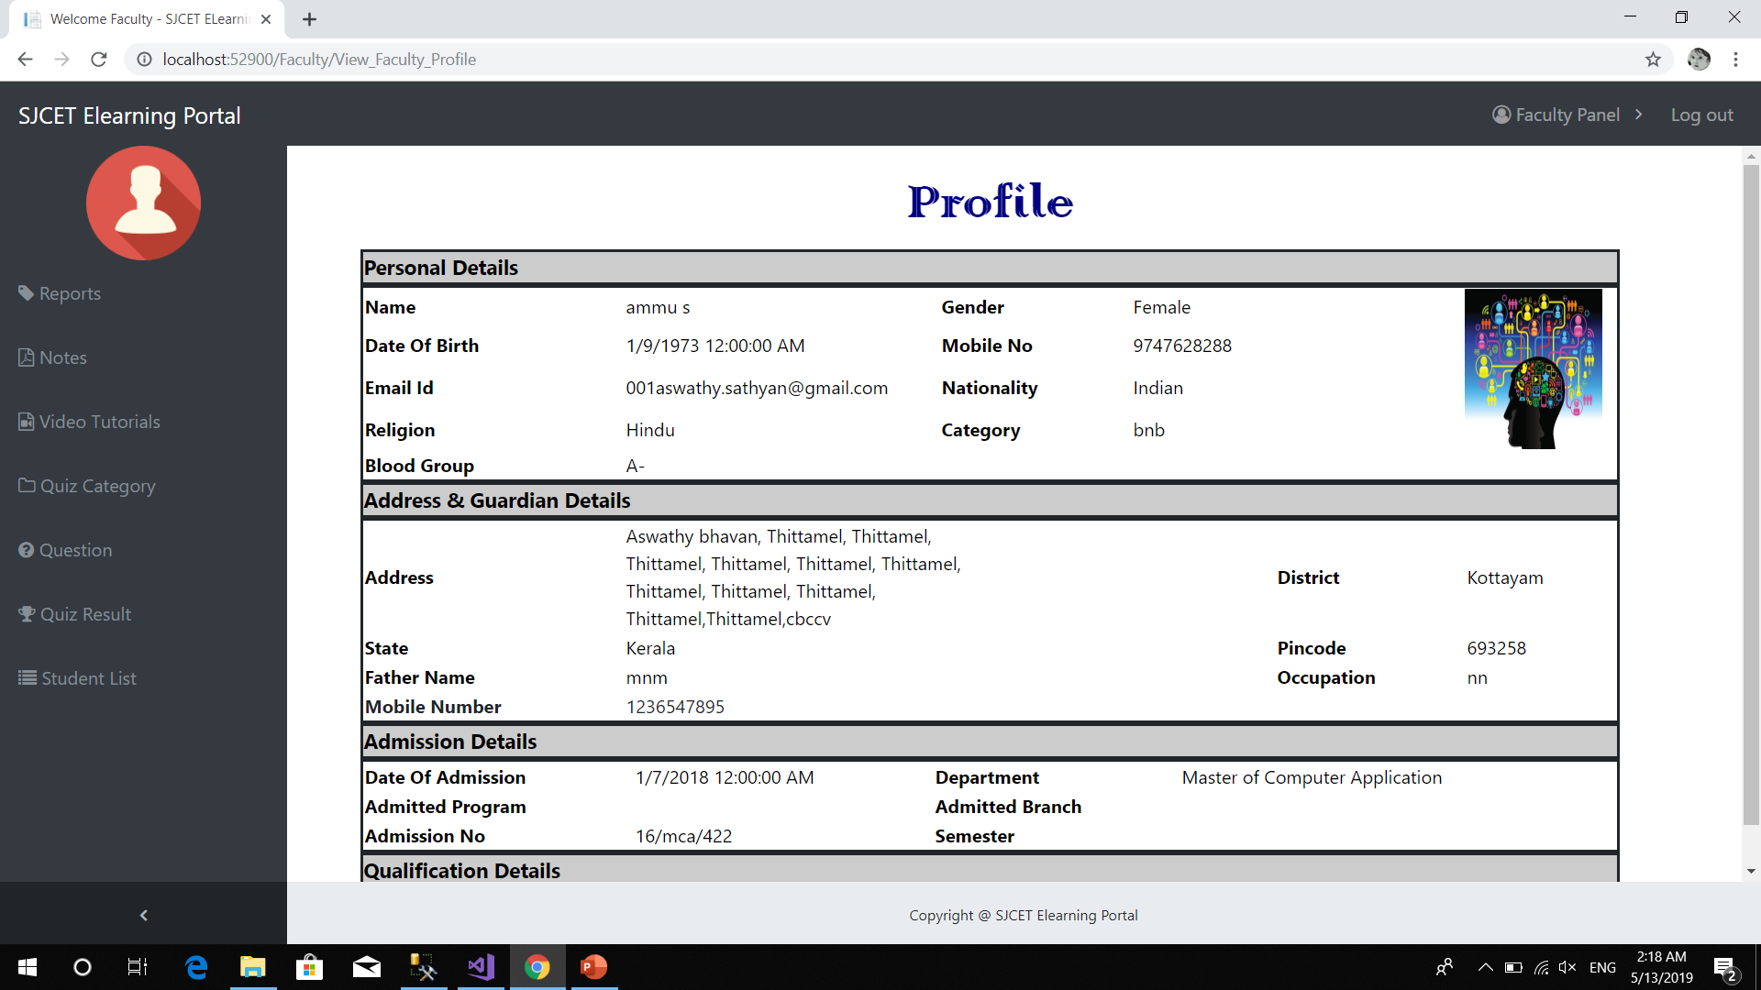
View profile

Slide 57
conclusion
E-resources serve as a platform for random access to multiple users at the same time and save plenty of time. E-learning has developed very fast due to internet.
This project supports teaching and learning using a computer web technology by sharing documents like notes, reports or video tutorials. Students can post their queries and they can view replies provided by different Faculty. This project helps Students to improve their aptitude skills by attending online quiz.

Slide 58


